Slide 1

Climbing ahead, falling behind: social mobility across time and space
Week 6
May 27, 2024
Dr. Louis Henderson

Slide 2
What causes social mobility to vary?
Credit constraints
Inequality
Educational spending
Heritability of traits
...what else?

Slide 3
Social mobility in economic history
Many of these factors change slowly, long-run collection of data may be necessary to study and understand their effects
These changes may be:
Structural Incentives Technological change Competitiveness | Institutional Policy Revolution Culture

Slide 4
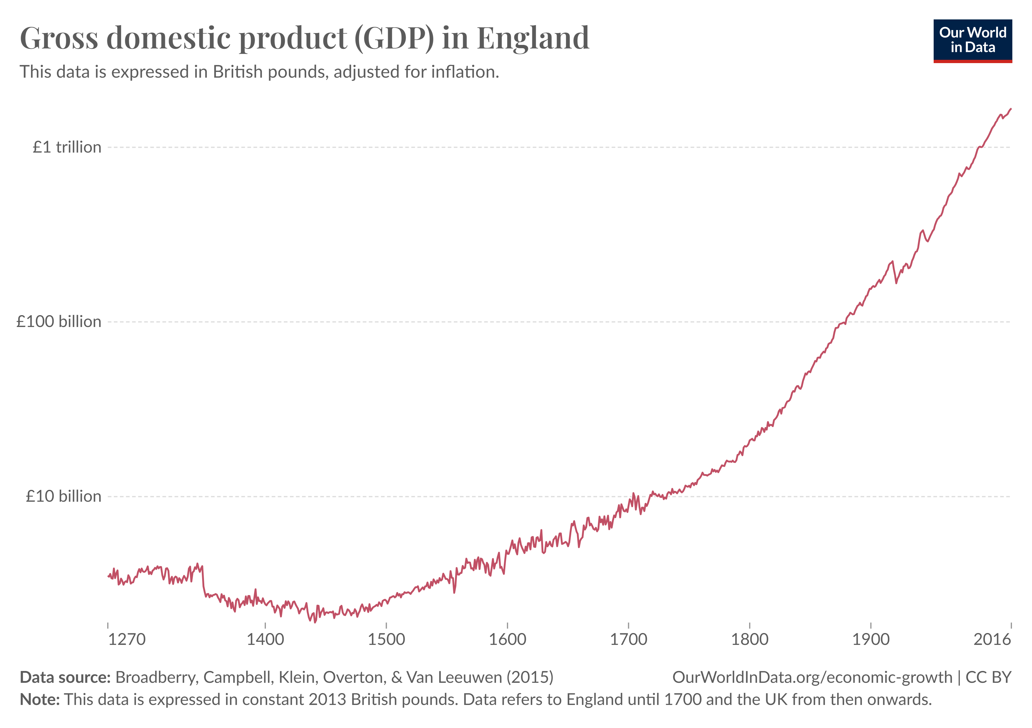
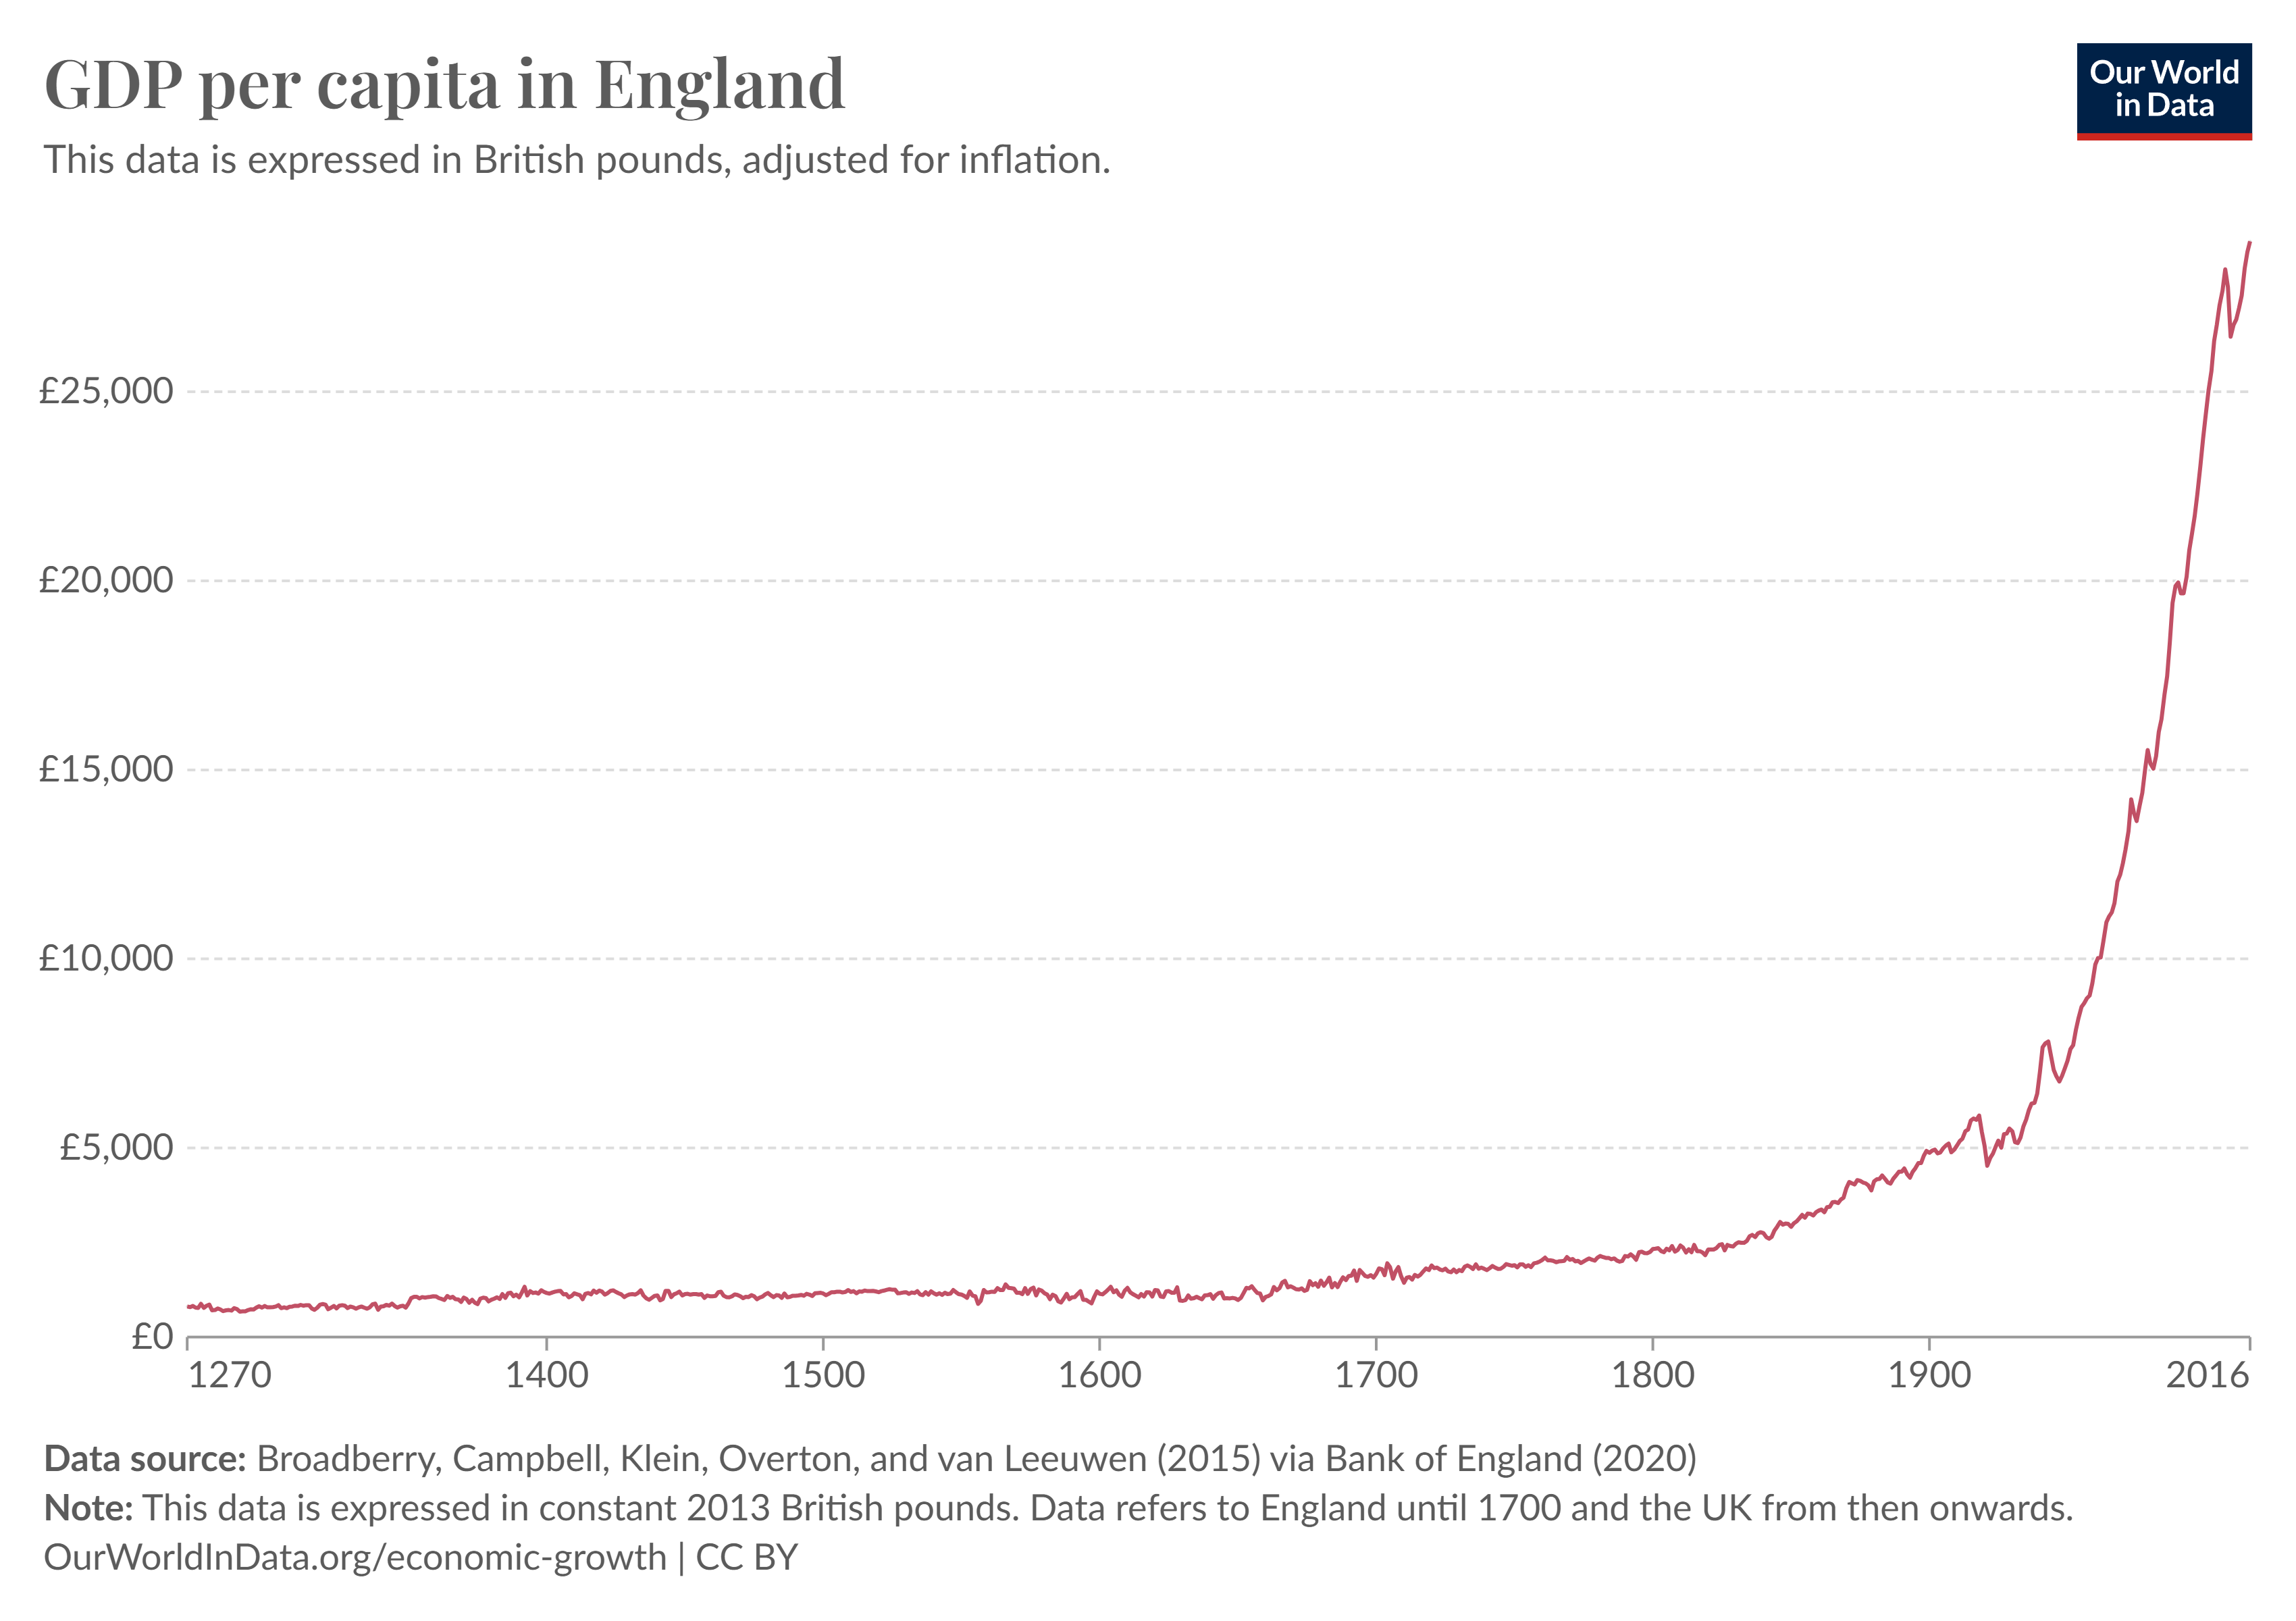
Economic growth
(Broadberry et al 2015)

Slide 5
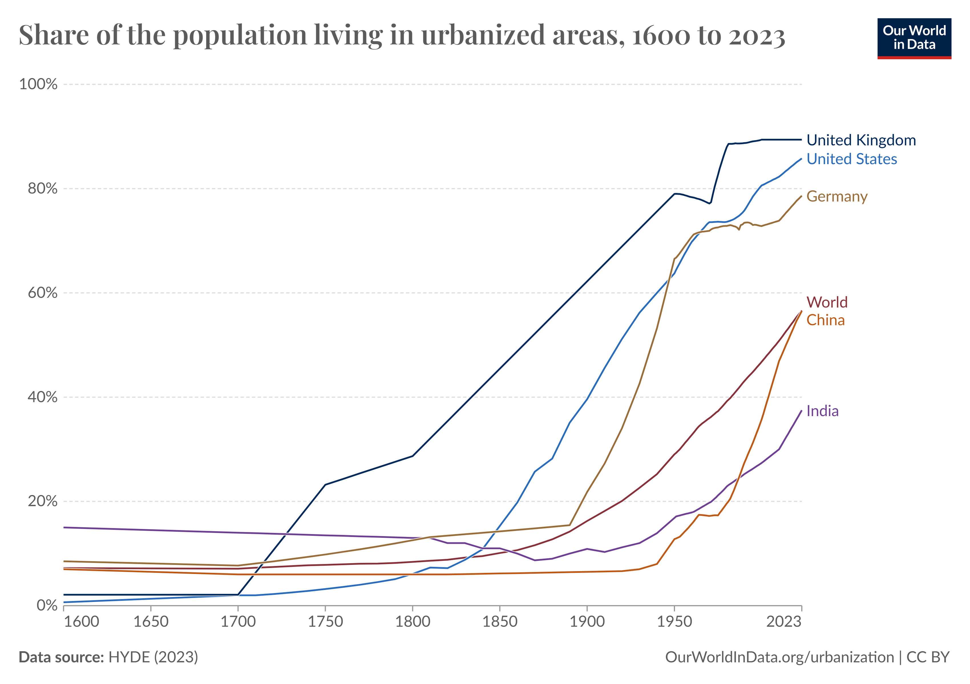
Urbanisation
(Ritchie, Samborska & Roser 2018)

Slide 6
Structural change
Sector | 1600 | 1710 | 1817 | 1851 | 1871
Primary | 65.0 | 50.8 | 39.4 | 32.4 | 25.6
Secondary | 27.0 | 37.2 | 42.1 | 44.7 | 46.3
Tertiary | 8.0 | 12.0 | 18.4 | 22.8 | 28.0
(Shaw-Taylor & Wrigley 2014)

Slide 7
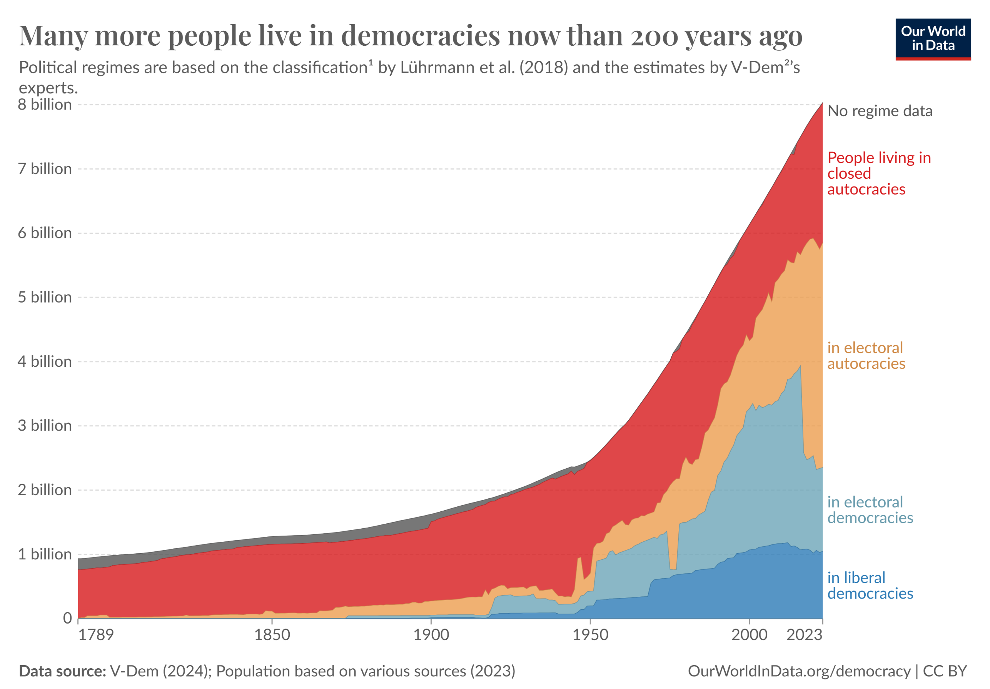
Institutional change
(Ritchie, Samborska & Roser 2018)

Slide 8
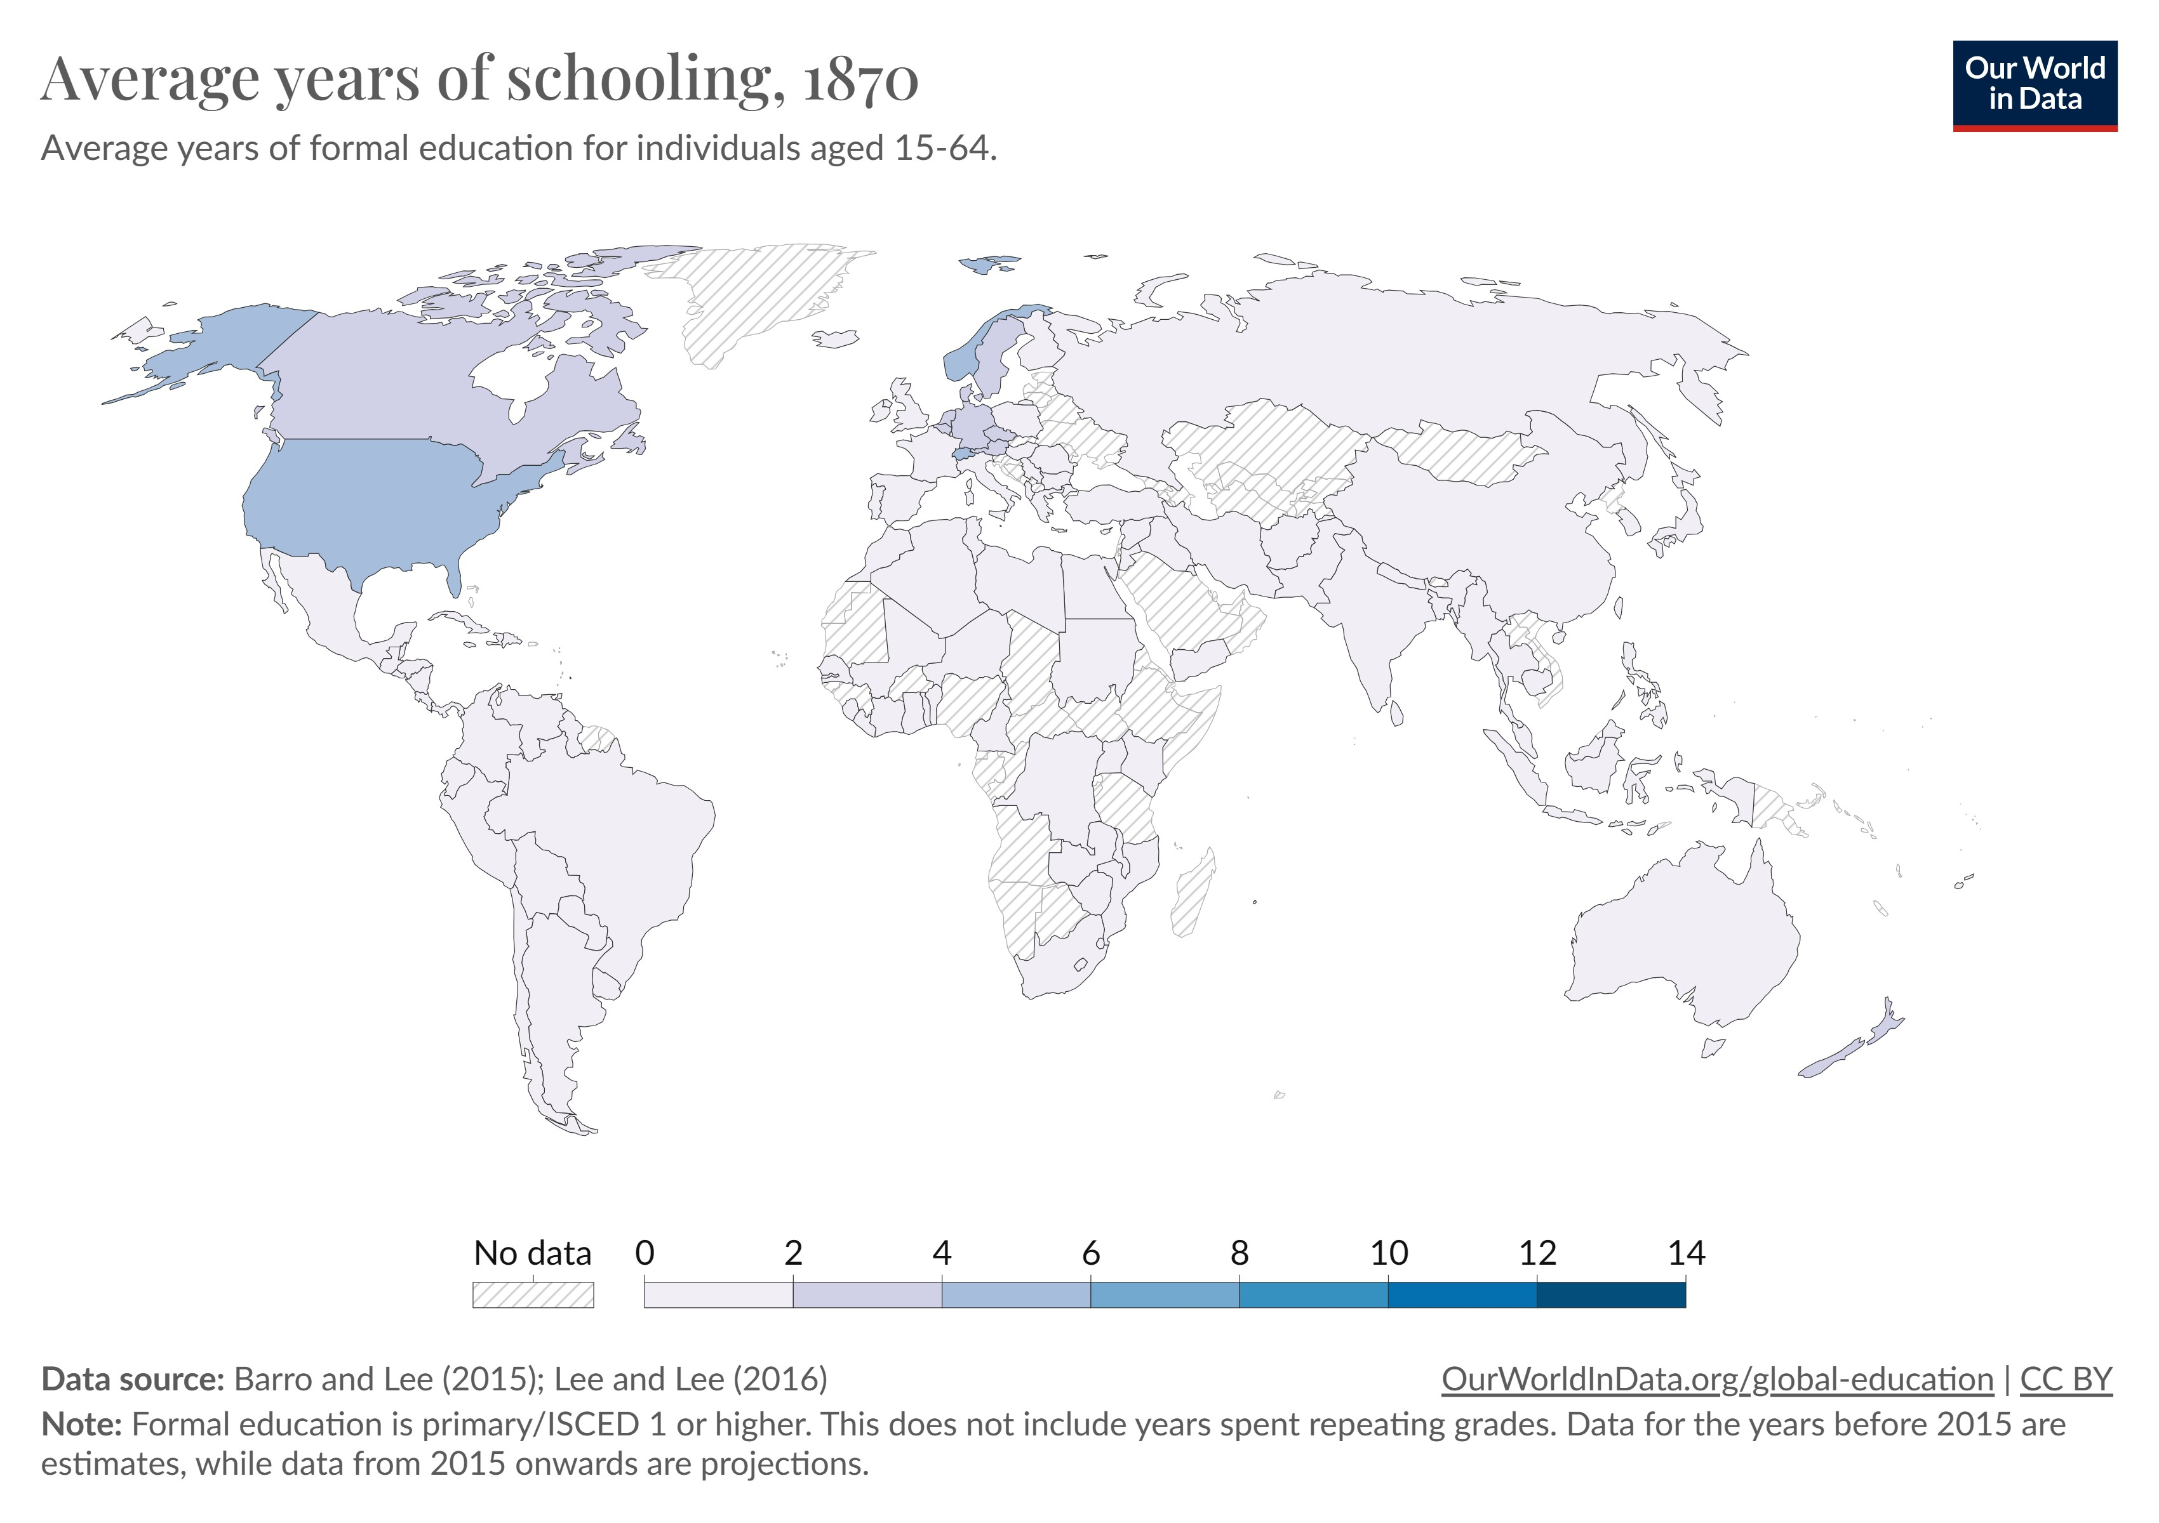
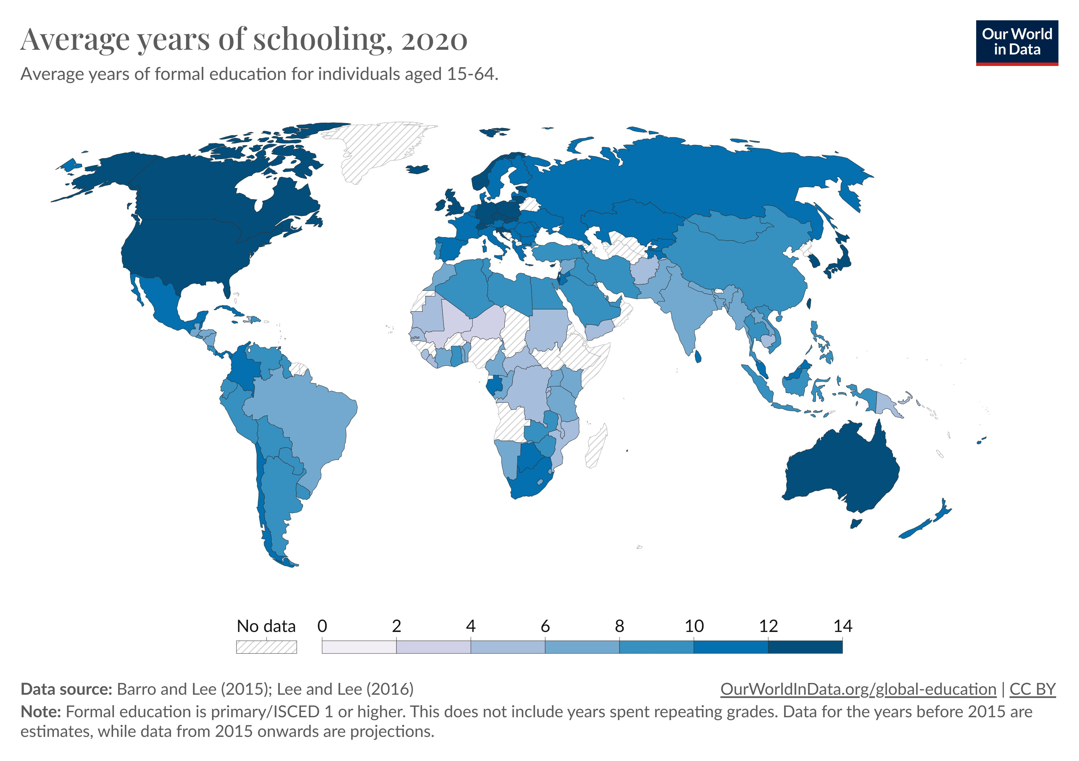
Institutional change

Slide 9
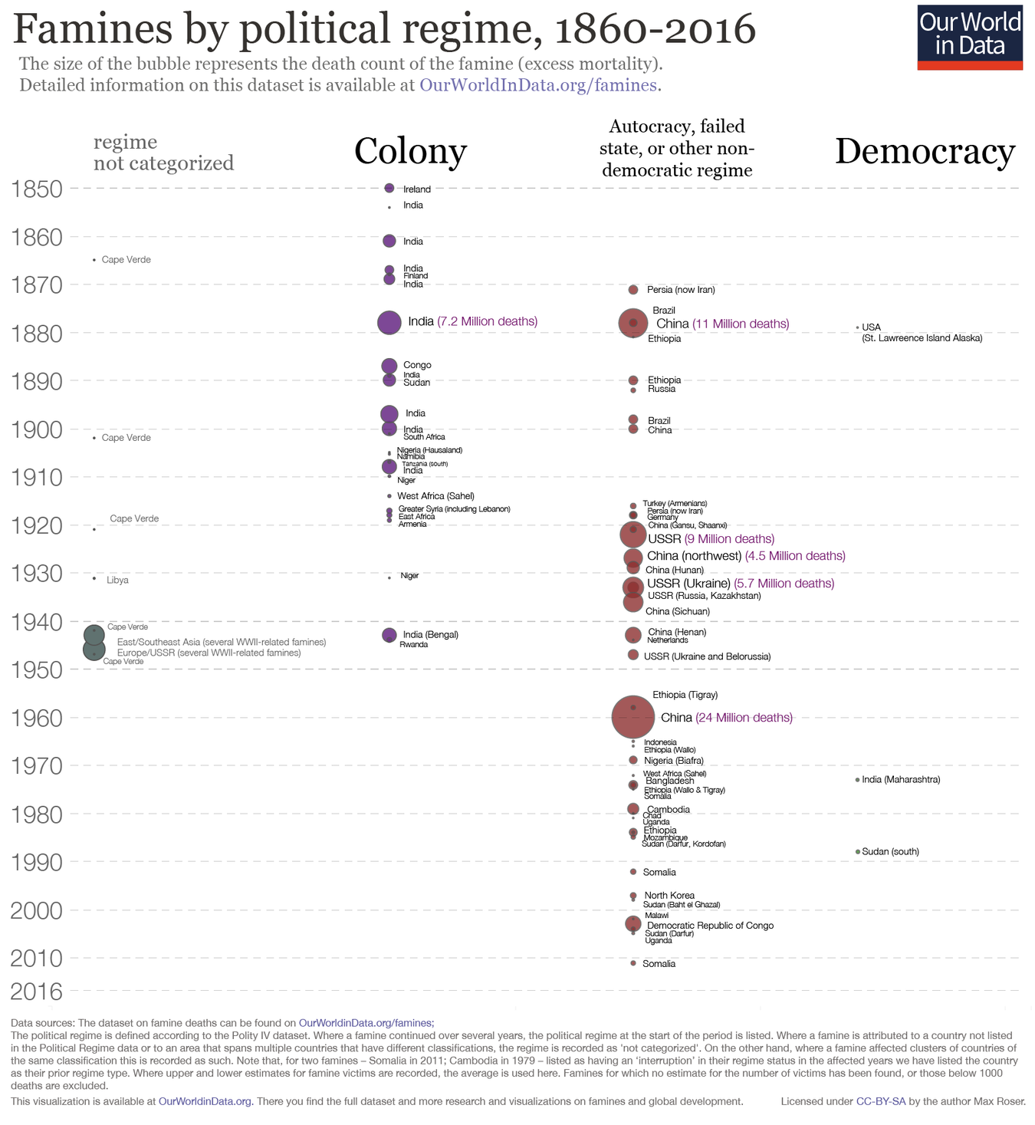

Slide 10
Social mobility in the long run
Social scientists have hypothesized that these changes will cause social mobility to increase over time
Generally, this is true of relative odds ratios (Heath & Li 2024) and intergenerational elasticities (Lambert et al. 2007)
However, several important results suggest slower change than might be expected (Goldthorpe 2013; 2016).

Slide 11
Social mobility in the long run
Example: study of four generations of Malmö residents in 20th century (Lindahl et al. 2015)
Persistence of educational achievement and income at least twice as large as conventional two-generation estimates
Great-grand-parent’s education predicts own education
Grandparent’s income predicts own income

Slide 12
Social mobility in the long run
Clark & Cummins’s surname persistence approach has been influential and controversial
Concept: examine over-representation of “elite” surnames in select social groups over time
Infer a rate of intergenerational mobility from rate of convergence to mean
They find much higher intergenerational elasticities than conventional approaches

Slide 13
Social mobility in the long run
Two sets of rare surnames:
Surname is rare if fewer than 40 people have the name in 1881 census
Attended Oxford or Cambridge in 1830s
Top 5% of wealth distribution in 1858-87
How much more likely are they to matriculate at Oxford or Cambridge over time?

Slide 14
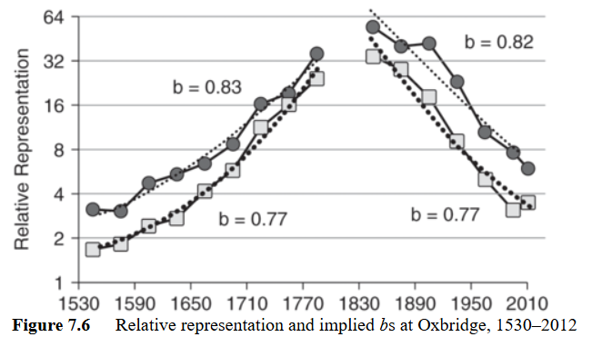
Social mobility in the long run
Source: Clark and Cummins (2012); circles for wealth, squares for Oxbridge

Slide 15
Social mobility in the long run
Much less intergenerational mobility, largely unaffected by structural or institutional change
Suggests social mobility is largely a private-order phenomenon
Posit an underlying “social competence”, individuals may make different trade-offs
Professor of Philosophy gets more prestige, but a management consultant makes more money
Leads to error in estimate for two generations with mean zero in the long run for the group

Slide 16
Economic history and social mobility
Static (synchronic) | Dynamic (diachronic)
Compares two different states ‘Ceteris paribus’ Equilibrium adjustment methodologically ‘timeless’ | Incorporates change over time Adjustment path and initial conditions may matter Multiple equilibria “Logical” time versus “historical” time (Robinson 1956)

Slide 17
Historical trajectories differ
Countries with similar degrees of social mobility today may have looked very different in the past, or vice versa
Scandinavian countries have higher social mobility today than U.S. (Björklund & Jäntti 2011), but U.S. was historically highly mobile society
Do these trajectories matter?

Slide 18
U.S., U.K., and Norway
(Modalisi 2017)

Slide 19
Social mobility and public choice
Alesina, Glaeser, & Sacerdote (2001) observe marked difference in extent of redistributive policies between U.S. and Europe
Posit a theory to predict political demand for these policies based on:
Median voter’s place in income distribution
Within- and between-period income variability (inequality & social mobility)
Political power of the poor
Altruism
Authors rule out the first two explanations

Slide 20
Social mobility and public choice
Alesina, Glaeser, & Sacerdote (2001) observe marked difference in extent of redistributive policies between U.S. and Europe
Posit a theory to predict political demand for these policies based on:
Median voter’s place in income distribution
Within- and between-period income variability (social mobility)
Political power of the poor
Altruism
Authors rule out the first two explanations

Slide 21
Political power of the poor
Alesina et al. highlight differences in voting systems and constitutions between U.S. and Europe
US:
two-party system, majoritarian winner
constitution (1789) and powerful judiciary protects property
Europe:
multi-party, proportional system
Europe less politically stable, later constitutions (e.g. Germany)

Slide 22
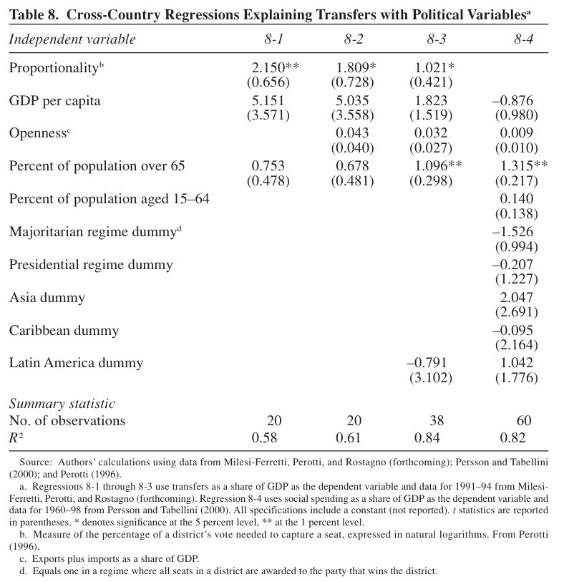
*Implies if the U.S. had same electoral system as Sweden, they would have similar welfare state
(Alesina et al 2001)

Slide 23
Political power of the poor
Proportional electoral systems leave space for third parties representing the poor
No socialist or worker’s party in the U.S.
Later constitutions tend to contain more “positive” rights, and more redistributive policies (exception Belgium and Netherlands) (Alesina et al. 2001)
BUT electoral system likely endogenous
(Alesina et al 2001)

Slide 24
Altruism and fairness
 | EU | US
Believe poor are trapped in poverty | 60 | 29
Believe luck determines income | 54 | 30
Believe the poor are lazy | 26 | 60
Beliefs about social mobility differ between EU and US
This possibly determines demand for electoral reform in the first place
(Alesina et al 2001)

Slide 25
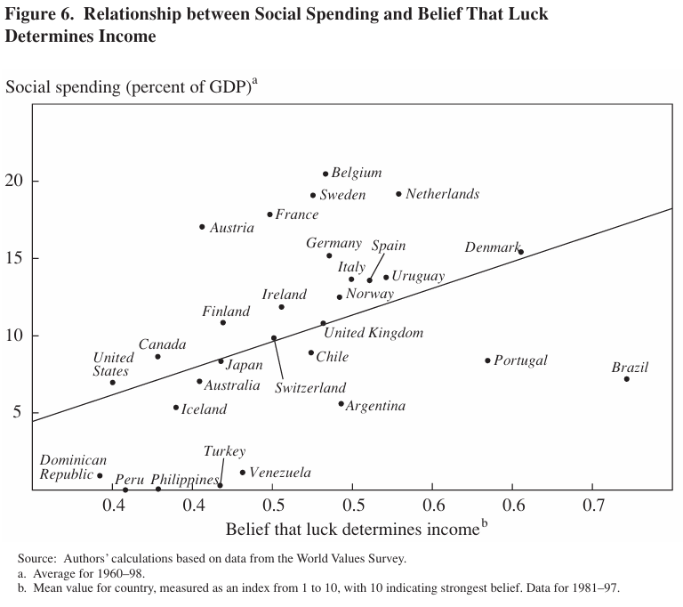
Altruism and fairness
(Alesina et al 2001)

Slide 26
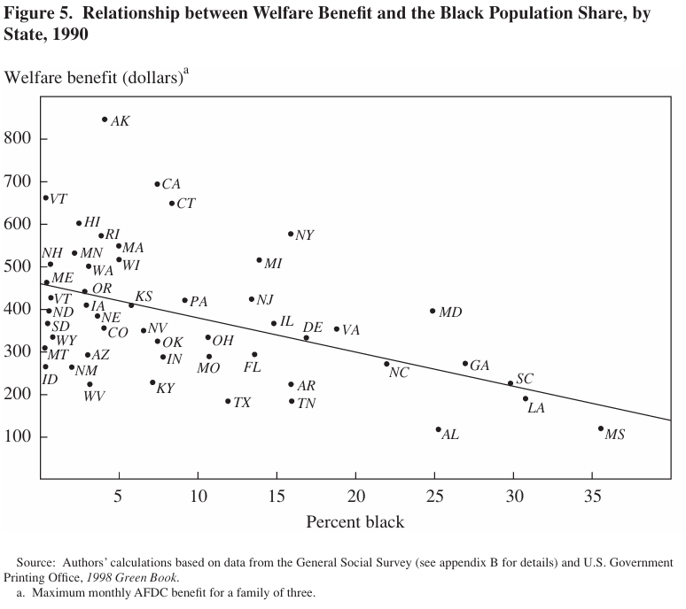
Altruism and fairness
(Alesina et al 2001)

Slide 27
Altruism and fairness
Where do these different beliefs come from?
National belief in “US exceptionalism”
Frontier and rapid growth
History of racial slavery
Because the American historical trajectory is basically unique, it is very hard to test hypotheses if we accept strong historical persistence
(Alesina et al 2001)

Slide 28
North and South
Long-standing regional differences in England
Boberg-Fazlic and Sharp (2018) ask whether long-run differences in social mobility translate into support for redistributive policies
Caveat: excludes geographically mobile
North | South
Initially poorer | Poorer after 18th century
Pastoral farming | Arable farming
Lower inequality | Higher inequality
Less urbanised | More urbanised

Slide 29
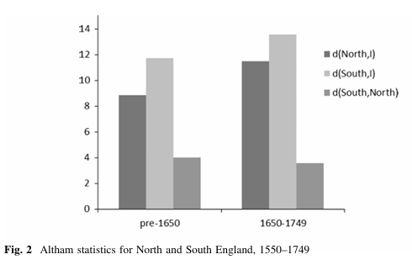
North and South
Differences extend to (non-farm) long-run social mobility
Greater probability of upward mobility in the north than the south
(Note: Altham statistics are comparable to 20th century)

Slide 30
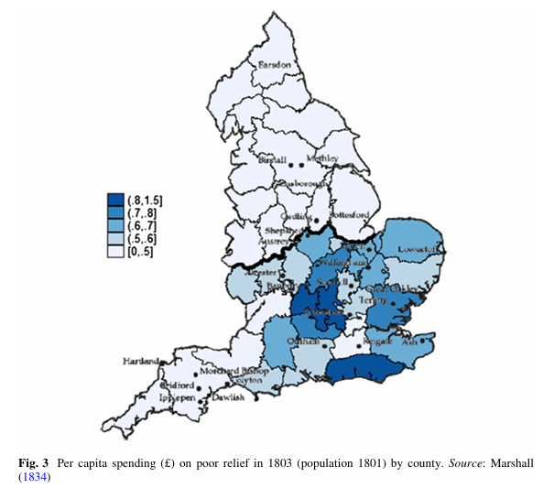
North and South
Poor relief system in England decided at local (parish) level
Before 20th century, welfare policy varied regionally
Sharp differences between north and south

Slide 31
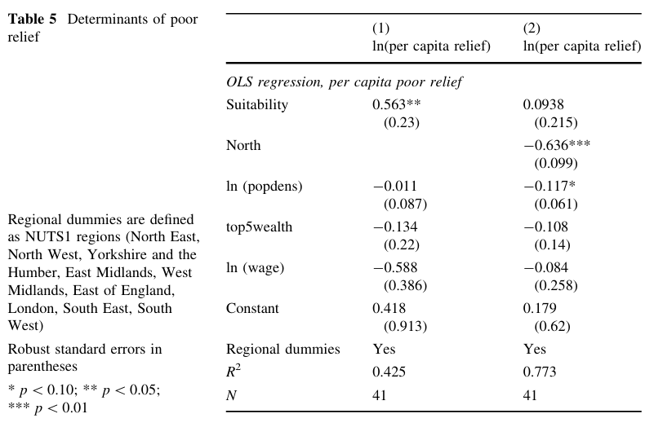
North and South

Slide 32
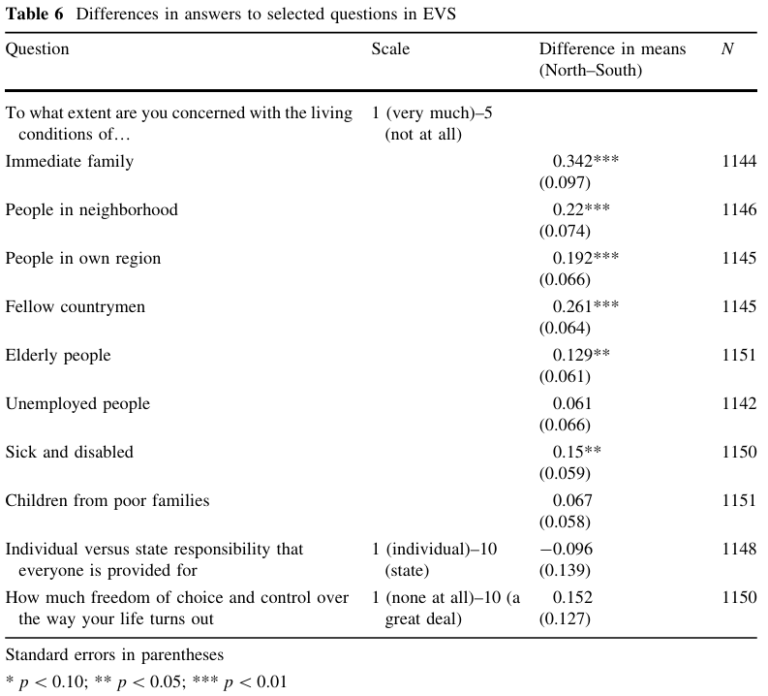
North and South

Slide 33
Economic history and social mobility
Some evidence that historical experience of social mobility persists through policy choice and attitudes
Historical trajectories (narratives) may therefore be important in explaining differences
Alternatively, long-run studies give different results than conventional studies of intergenerational mobility
How does this affect your approach to understanding social mobility in your chosen case study?

Slide 34
Thank you!

